Slide 1
Authentication
Lesson Introduction
Understand the importance of authentication
Learn how authentication can be implemented
Understand threats to authentication

Slide 2
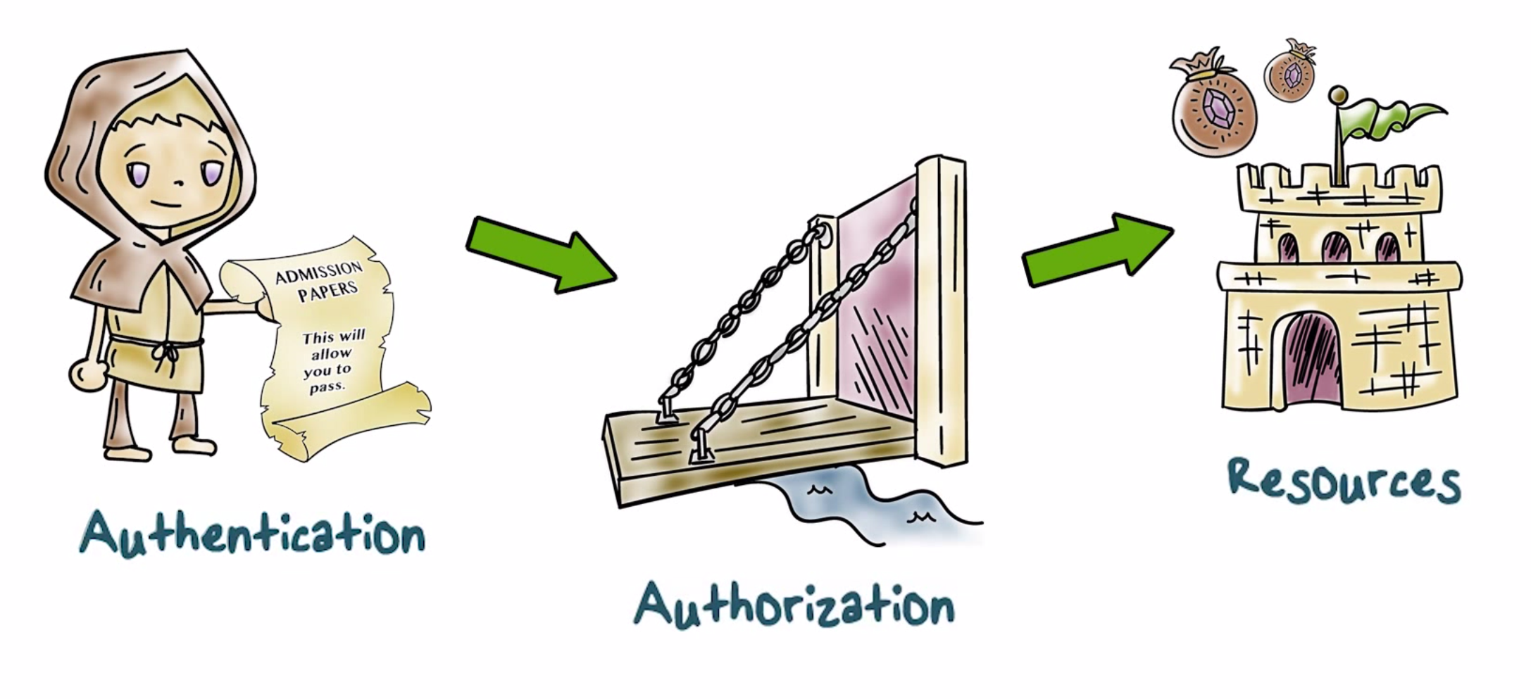
What is Authentication?

Slide 3
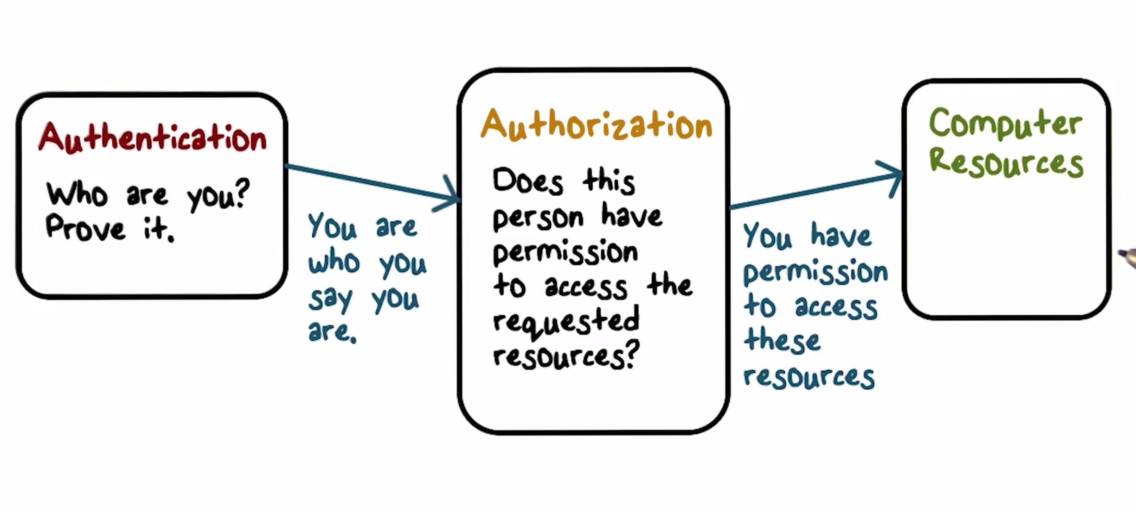
What is Authentication?

Slide 4

What is Authentication?
OS (TCB) needs to know who makes a request for a protected resource
A process that makes the request does it on behalf of a certain user, subject or principal
Authentication helps us answer the question: on whose behalf the requesting process runs?
Includes claims about an identity and verification of the claimed identity of the user who wants to gain access to system and resource

Slide 5

Authentication Goals
User/principal associated with an identity
should be able to successfully authenticate itself
Availability
No false negatives
User/principal not associated with the identity should not be able to authenticate itself
Authenticity
No false positives

Slide 6

Authentication Quiz
Check the correct answer from the choices.
We now have personal devices that are not shared across multiple users. What threats motivate the use of authentication in such devices?
Malware infection that may exfiltrate sensitive data
Loss of theft of the device

Slide 7



How is Authentication Implemented?
Three basic methods:
Something a user has
Something a user knows
Something a user is

Slide 8
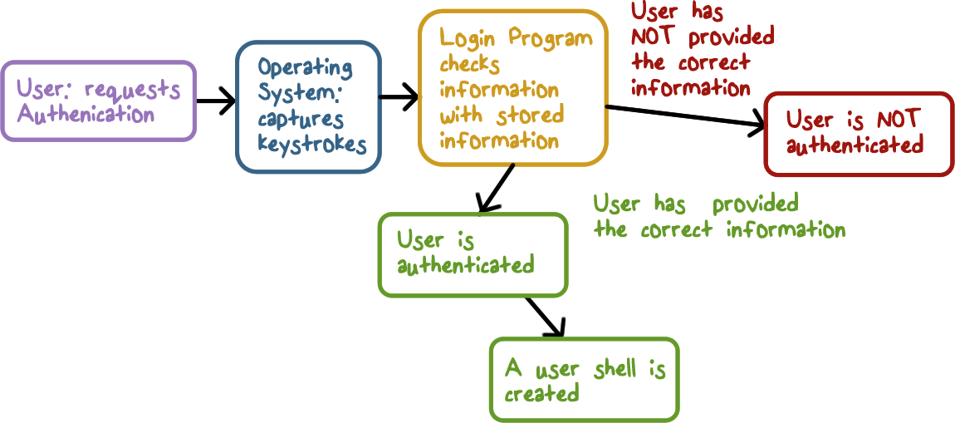
How is Authentication Implemented?

Slide 9
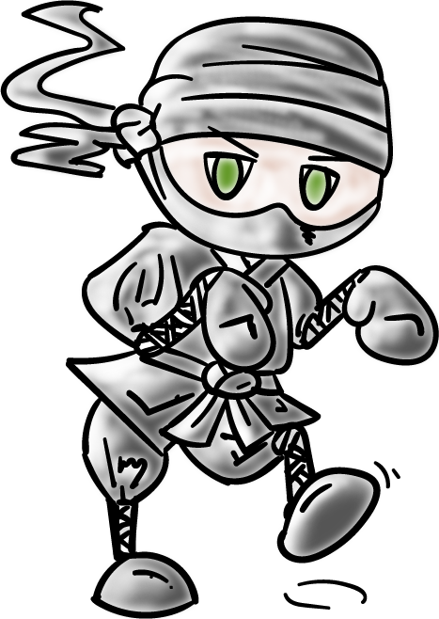
Login Attacks Quiz
Check the correct answer from the choices.
An attacker correctly guesses Alice’s password and logins in as her. Is this a case of...
False positive
True positive

Slide 10
Implementation Quiz
Check the correct answer from the choices.
A number of online banking systems send a limited lifetime PIN to your smartphone for you to be able to authenticate yourself to the bank. Is this an example of...
Something you have
Something you are

Slide 11

Threat Modeling of the Password Method
Guessing the password for a given user allows impersonation
Impersonating a real login program
Keylogging to steal a password

Slide 12

Importance of a Trusted Path
Hardware/OS must provide a
trusted path:
Windows CNTL-ALT-DEL
Keyboard and display must have trusted paths to OS
Special kind of display under OS control
Do users pay attention?

Slide 13
Password Popularity Quiz
Check which passwords made the top 10 most
common passwords for 2014:
123456 696969
password 123123
letmein batman
abc123 qwerty
111111 123456789
Notes:
123456, password, qwerty, 123456789
The rest of the selections are in the top 25 of most common passwords. These passwords are so common they are often used in a reverse­ brute­force­attack, where each password is tested against multiple users.

Slide 14
Implementing Password Authentication
How do we check the password supplied with a user id?
Method 1 - store a list of passwords, one for
each user in the system file.
The file is readable only by the root/admin account
What if the permissions are set incorrectly?
Why should admin know the passwords?
If security is breached, the passwords are exposed to an attacker.

Slide 15
Implementing Authentication
How do we check the password supplied with a user id?
Method 2 - do not store passwords, but store something that is derived from them
Use a one-way hash function and store the result
The password file is readable only for root/admin

Slide 16
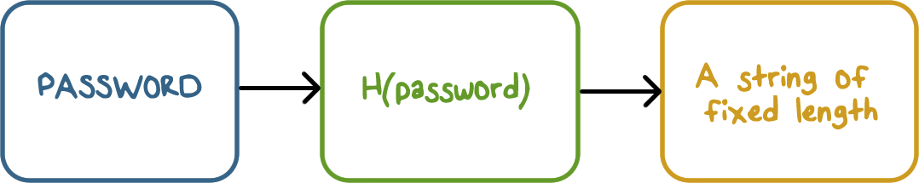
Hash Functions

Slide 17
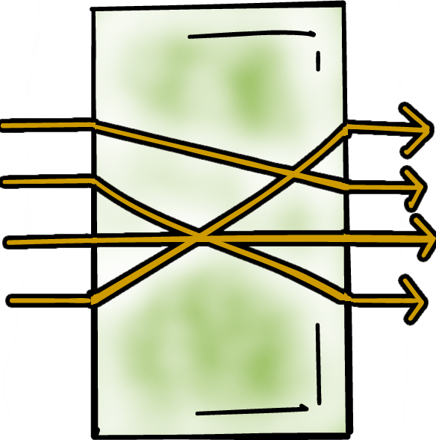
Hash Functions & Threats
We assume a one-way property for hash functions
If we know common passwords, we can determine their hash
For dictionary and offline attacks, we have the hash values and plenty of time to test for matches

Slide 18
Password Quiz
If we do not have a trusted path between a user and the system, what problem may occur. Check the correct answer(s):
User is not able to log into the system
User may provide the password to a malicious program

Slide 19
Hashed Passwords Quiz
In the past, hashed passwords were stored in a publicly readable file /etc/passwd. Why were shadow password files added instead of making/etc/passwd file readable only to privileged users?
Shadow files are more efficient to access
There is other public information in /etc/passwd file that various utilities need

Slide 20
Hash Function Characteristics Quiz
The hash function used for computing hashed password values should meet the following requirements. Check the correct answer(s):
Provide more efficient storage of password related information
Produce different hashed values for distinct passwords
Its inverse should be very hard to compute

Slide 21
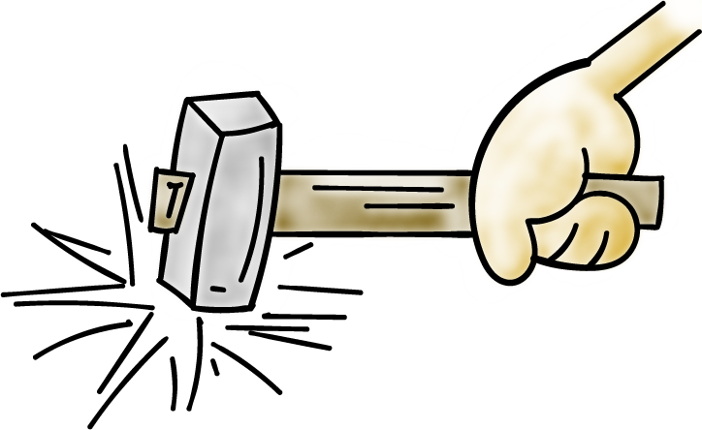

Brute Force Guessing of Passwords
Publicly available software can do 10⁸ MD5 hashes/sec on a GPU
Six random upper case/lower case/digits then 62⁶ possible passwords, about 10 minutes
Eight random characters increases it to about six days

Slide 22
Brute Force Guessing of Passwords
Passwords are not really random
To reduce the work required for a brute force attack:
Try the popular passwords first
Create a rainbow table

Slide 23
Brute Force Guessing of Passwords
What if two users pick the same password?
Add a random salt before hashing
Store the salt with the hashed value
Check by using the salt with the typed password

Slide 24
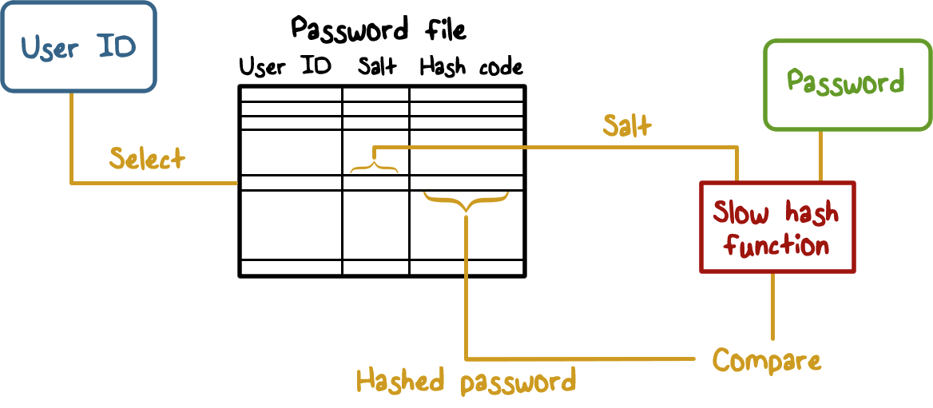
Brute Force Guessing of Passwords

Slide 25
Unique PINs Quiz
How many unique four digits PINs are possible? Check the correct answer:
1,000
100,000
10,000
1,000,000

Slide 26
Brute Force Quiz
A randomly chosen password has six characters that include upper and lower case letters, digits (0-9) and 10 special characters (examples are +, ; etc.). In the worst case, how many attempts must a brute-force method make to determine a password when its hashed value is available?
Check the correct answer:
6⁷²
62⁶
72⁶

Slide 27
Touch Screen Passwords Quiz
In smartphone touch screens, pattern based passwords are used to unlock the device. It is believed that such patterns are not random and there is a bias in where users start. This can be explained by ...
Check the correct answer(s):
Users often start at a random point but then fall back to a common pattern
There is bias in starting at a point near the top left of the screen
The ease of moving from current to next point introduces bias

Slide 28

Problems with Passwords
As password length and complexity increases, usability suffers
Phishing and social engineering – users do not authenticate who is asking for a password.
Once a password is stolen, it can be used many times
This is why there are policies that say passwords be changed frequently
Humans have a hard time remembering lots of passwords. Usable passwords are easy to guess.

Slide 29

Problems with Passwords
Sys Administrators:
Never store passwords in the clear
Store only hashed values generated with a random salt and limit access to them
Avoid general purpose fast hash functions
Users:
Use password managers

Slide 30
Other Authentication Methods
Something you have:
You must have them
May require additional hardware (e.g., readers)
How does it implement authentication (challenge/response)
Cost and misplaced trust (RSA SecureID master key breach)
Tokens, smart cards

Slide 31
Other Authentication Methods
Something You Are:
Various biometrics
Fingerprints (finger swipes)
Keystroke dynamics
Voice
Retina scans
Do you get the same biometric measurement each time?
Probability distribution or a range for feature values
False positives and negatives

Slide 32
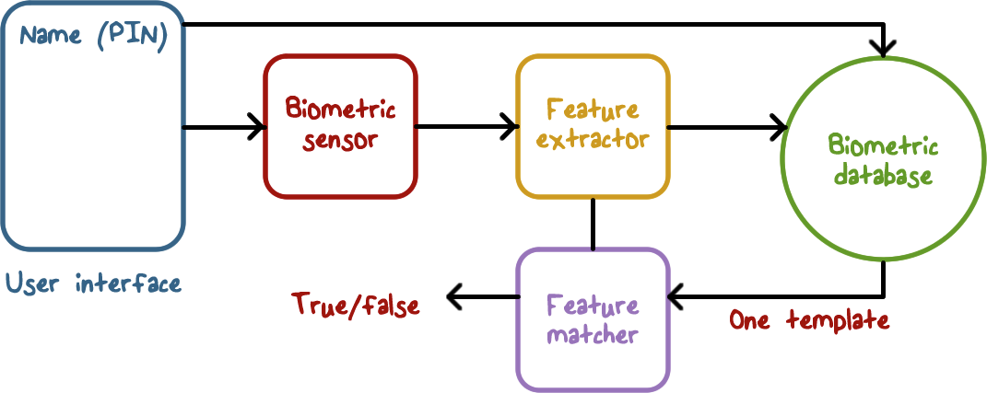
Implementing Biometric Authentication

Slide 33
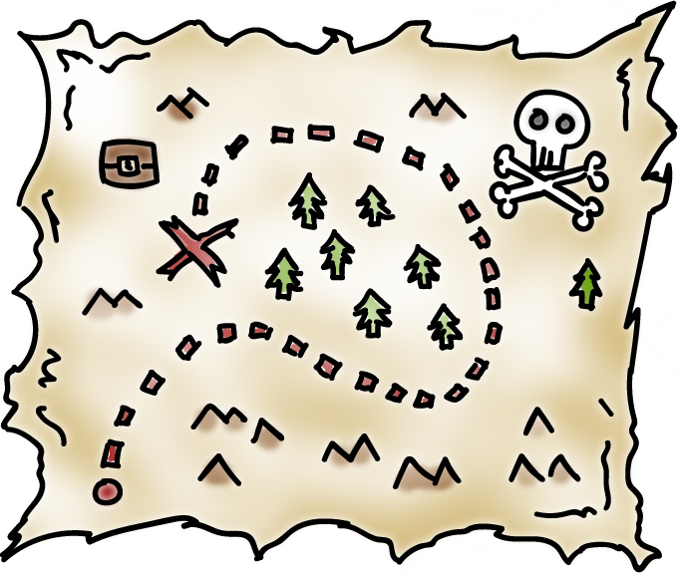

Other Authentication Methods
Multi-factor authentication
Uses more than one method
Type password but also send a code via SMS
It goes to your phone (something you have)
Gmail implements this
ATM card and a PIN
Other things like your location
Attacker must defeat both to compromise authentication

Slide 34
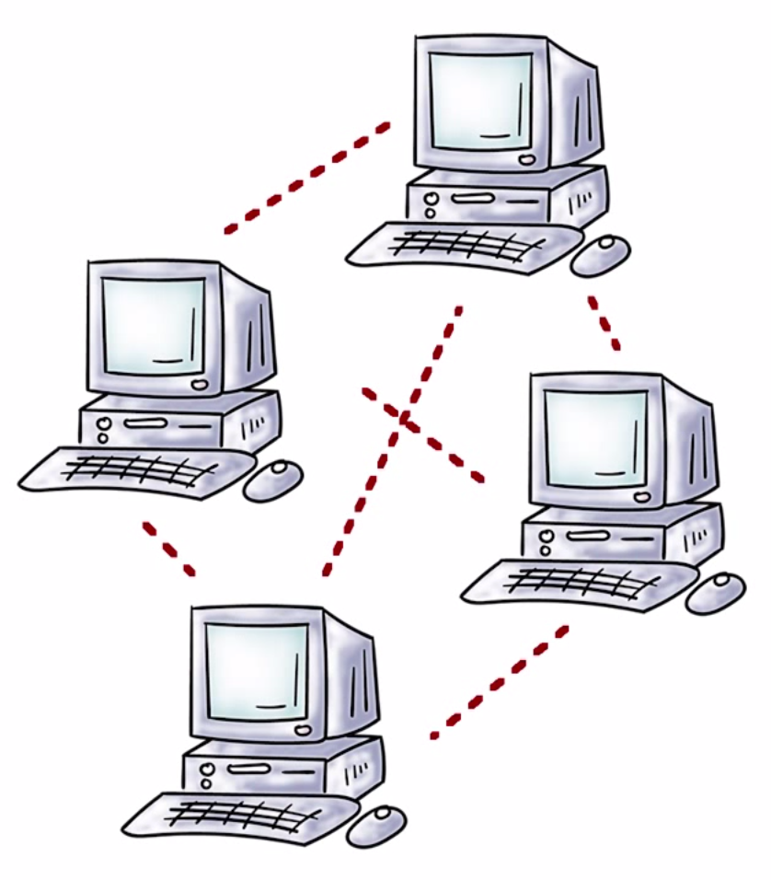
Other Authentication Methods
Authentication over a network:
Do we always have a trusted path to the OS we need to authenticate to?
Remote services
Network authentication introduces new problems
Need crypto to secure network communication
Other attacks (man-in-the-middle)

Slide 35
Multi-factor
Authentication Quiz
A multi-factor authentication method will likely reduce false positives. Choose one:
True
False

Slide 36
Chip and Pin Authentication Quiz
Although a “something you have” based authentication method avoids problems associated with passwords, it could also be prone to attacks. For example, read about chip and pin based authentication at the link listed in the instructor notes.
Lost cards
What is the main weakness that is illustrated here?
Cloning of cards
Vulnerabilities in implementation
Notes:
https://www.schneier.com/blog/archives/2014/05/preplay_attack_.html

Slide 37
Biometric Authentication Quiz
Biometric authentication based on fingerprints can be hacked if an attacker can gain access to a user’s fingerprint.
For example, it has been demonstrated that the Apple’s Touch ID can be fooled with lifted fingerprints. See the link in the instructor’s note.
Can a similar attack be mounted if voice biometric authentication is used?
Yes
No

Slide 38
Authentication
Lesson Summary
Authenitcation is a key requirement for securing access to resources
All methods present a number of tradeoffs that need to be balanced
Understand how various types of authentication is implemented
Security mindset requires that we do careful threat modeling

